Slide 1


R. DiPasquale
10/18/2023

Slide 2

Outline
Executive Summary
Introduction
Methodology
Results
Conclusion
Appendix

Slide 3
Executive Summary
Summary of methodologies
Summary of all results

Slide 4
Introduction
Project background and context
Problems you want to find answers

Slide 5

Section 1

Slide 6
Methodology
Executive Summary
Data collection methodology:
Describe how data was collected
Perform data wrangling
Describe how data was processed
Perform exploratory data analysis (EDA) using visualization and SQL
Perform interactive visual analytics using Folium and Plotly Dash
Perform predictive analysis using classification models
How to build, tune, evaluate classification models

Slide 7
Data Collection
Describe how data sets were collected.
You need to present your data collection process use key phrases and flowcharts

Slide 8
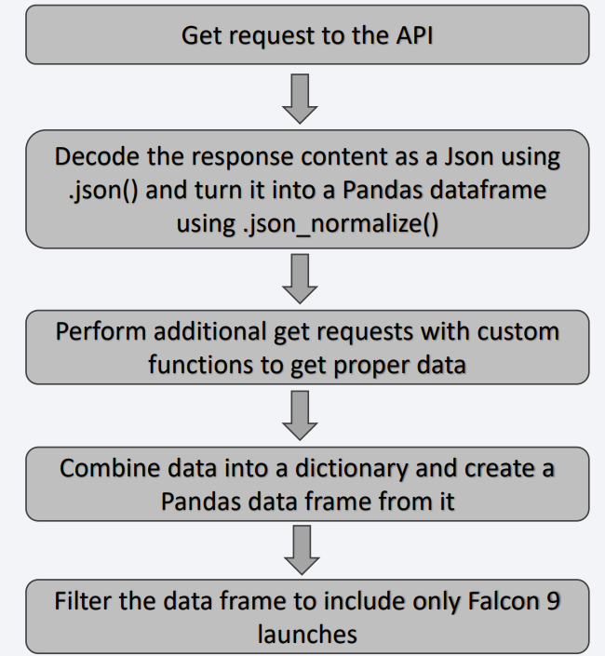
Data Collection – SpaceX API
Present your data collection with SpaceX REST calls using key phrases and flowcharts
Add the GitHub URL of the completed SpaceX API calls notebook :Capstone/jupyter-labs-spacex-data-collection-api (3).ipynb at main · beckdipo/Capstone (github.com)

Slide 9
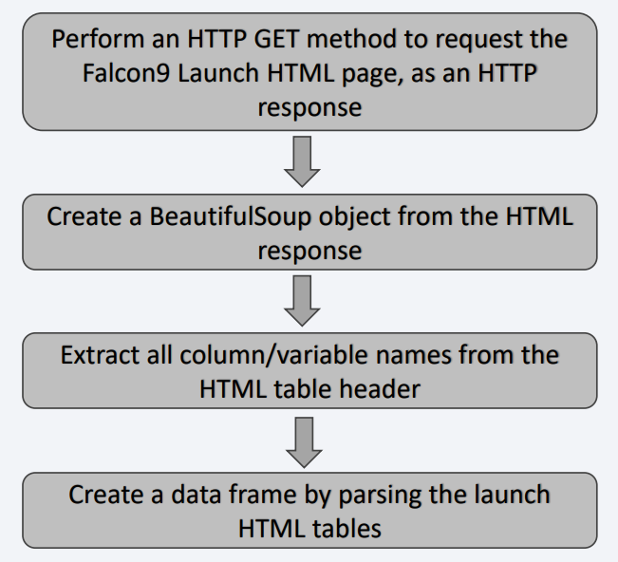
Data Collection - Scraping
Present your web scraping process using key phrases and flowcharts
Add the GitHub URL of the completed web scraping notebook, as an external reference and peer-review purpose: Capstone/jupyter-labs-webscraping.ipynb at main · beckdipo/Capstone (github.com)

Slide 10
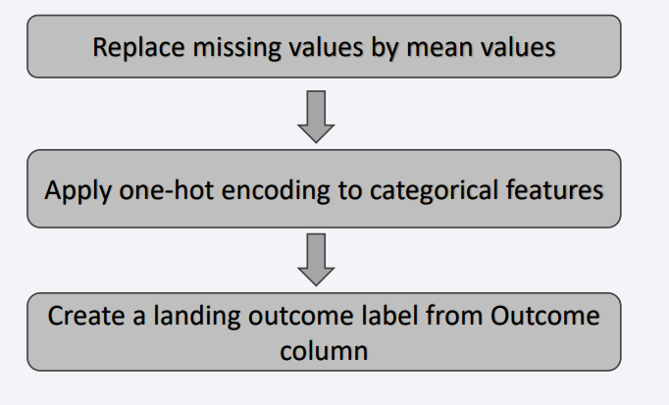
Data Wrangling
Describe how data were processed
You need to present your data wrangling process using key phrases and flowcharts
Add the GitHub URL of your completed data wrangling related notebooks, as an external reference and peer-review purpose: Capstone/labs-jupyter-spacex-Data wrangling.ipynb at main · beckdipo/Capstone (github.com)

Slide 11
EDA with Data Visualization
Summarize what charts were plotted and why you used those charts:
Scatter plot of flight number vs. payload mass
Scatter plot of flight number vs. launch sit
Scatter plot of payload mass vs. launch site
Bar plot of orbit type
Scatter plot of flight number vs orbit type
Scatter plot of payload mass vs. orbit type
Pine plot of launch success
Add the GitHub URL of your completed EDA with data visualization notebook, as an external reference and peer-review purpose Capstone/jupyter-labs-eda-sql-coursera_sqllite.ipynb at main · beckdipo/Capstone (github.com)

Slide 12
EDA with SQL
Using bullet point format, summarize the SQL queries you performed
Show names of launch sites
Show five records where launch site begin with “CCA”
Show total payload mass carried by boosters launched by NASA
Show average payload of mass carried
List date when successful landing was achieved
List names of boosters that has success in drone and mass greater than 400 and less than 6000
List total number of successful and fail missions
List names of boosters versions that carried maximum
Add the GitHub URL of your completed EDA with SQL notebook, as an external reference and peer-review purpose: Capstone/jupyter-labs-eda-sql-coursera_sqllite.ipynb at main · beckdipo/Capstone (github.com)

Slide 13
Build an Interactive Map with Folium
Summarize what map objects such as markers, circles, lines, etc. you created and added to a folium map:
Sites locations are easily discovered on a map with proximities to be studied
Explain why you added those objects
To identify the sites with success
Add the GitHub URL of your completed interactive map with Folium map, as an external reference and peer-review purpose: Capstone/lab_jupyter_launch_site_location.jupyterlite.ipynb at main · beckdipo/Capstone (github.com)

Slide 14
Build a Dashboard with Plotly Dash
Summarize what plots/graphs and interactions you have added to a dashboard
launch sit dropdown to select sites
Pie chart for success
Range slide to look at success rate
Scatter chart to show how payload affects success rate
Add the GitHub URL of your completed Plotly Dash lab, as an external reference and peer-review purpose: Capstone/spacex_dash_app.py at main · beckdipo/Capstone (github.com)

Slide 15
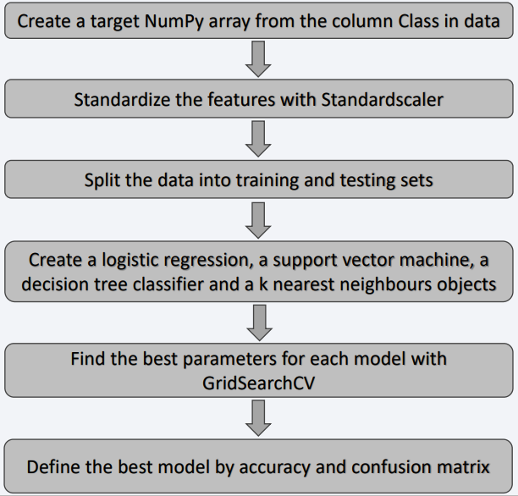
Predictive Analysis (Classification)
Summarize how you built, evaluated, improved, and found the best performing classification model
You need present your model development process using key phrases and flowchart
Capstone/jupyter-labs-spacex-data-collection-api (3).ipynb at main · beckdipo/Capstone (github.com)

Slide 16
Results
Exploratory data analysis results
Interactive analytics demo in screenshots
Predictive analysis results

Slide 17

Section 2

Slide 18
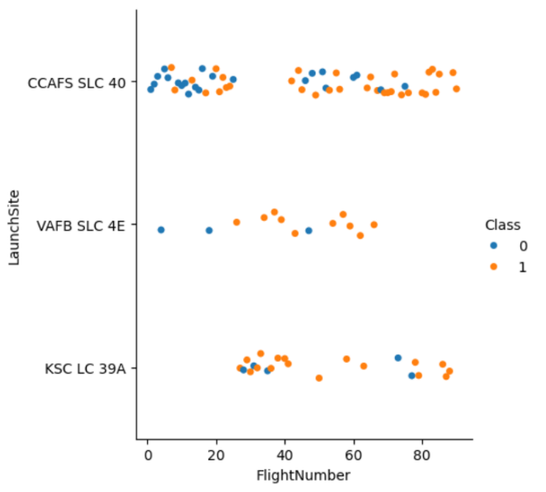
Flight Number vs. Launch Site
Show a scatter plot of Flight Number vs. Launch Site
Show the screenshot of the scatter plot with explanations

Slide 19
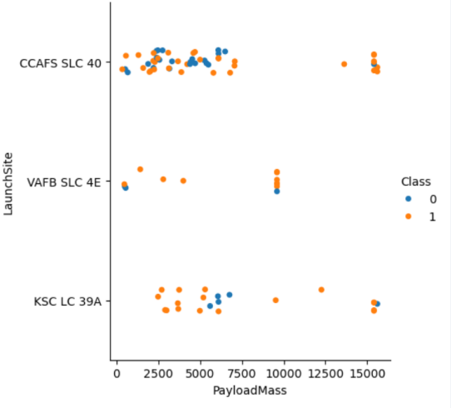
Payload vs. Launch Site
Show a scatter plot of Payload vs. Launch Site
Show the screenshot of the scatter plot with explanations

Slide 20
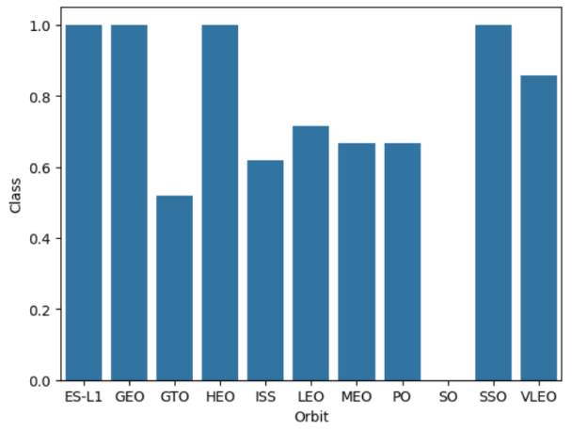
Success Rate vs. Orbit Type
Show a bar chart for the success rate of each orbit type
Show the screenshot of the scatter plot with explanations

Slide 21
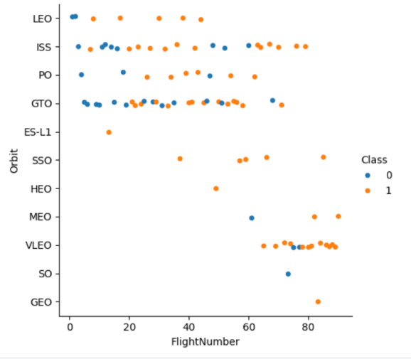
Flight Number vs. Orbit Type
Show a scatter point of Flight number vs. Orbit type
Show the screenshot of the scatter plot with explanations

Slide 22
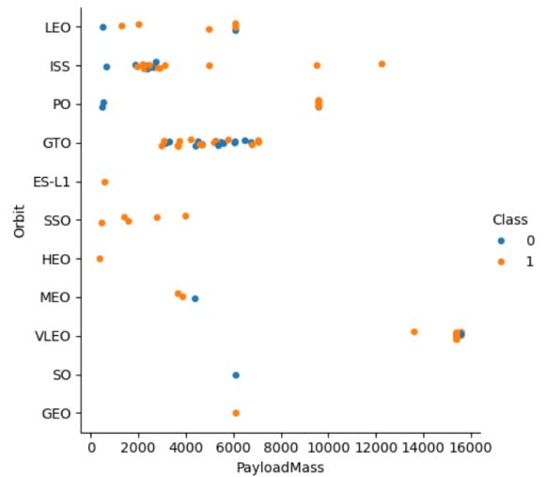
Payload vs. Orbit Type
Show a scatter point of payload vs. orbit type
Show the screenshot of the scatter plot with explanations

Slide 23
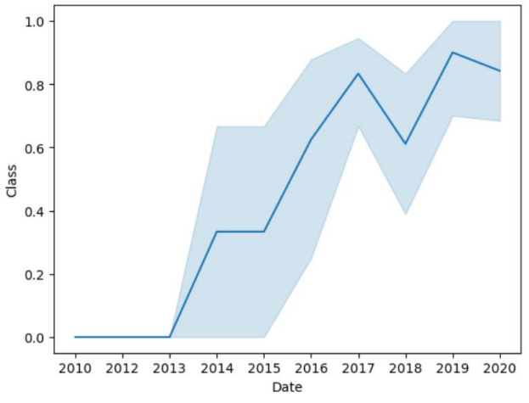
Launch Success Yearly Trend
Show a line chart of yearly average success rate
Show the screenshot of the scatter plot with explanations

Slide 24
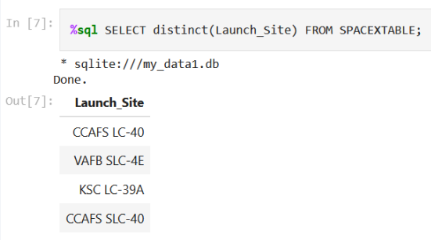
All Launch Site Names
Find the names of the unique launch sites
Present your query result with a short explanation here

Slide 25
Launch Site Names Begin with 'CCA'
Find 5 records where launch sites begin with `CCA`
Present your query result with a short explanation here

Slide 26
Total Payload Mass
Calculate the total payload carried by boosters from NASA
Present your query result with a short explanation here

Slide 27
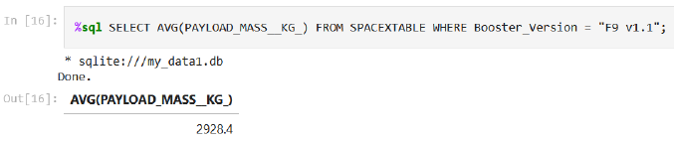
Average Payload Mass by F9 v1.1
Calculate the average payload mass carried by booster version F9 v1.1
Present your query result with a short explanation here

Slide 28
First Successful Ground Landing Date
Find the dates of the first successful landing outcome on ground pad
Present your query result with a short explanation here

Slide 29
Successful Drone Ship Landing with Payload between 4000 and 6000
List the names of boosters which have successfully landed on drone ship and had payload mass greater than 4000 but less than 6000
Present your query result with a short explanation here

Slide 30
Total Number of Successful and Failure Mission Outcomes
Calculate the total number of successful and failure mission outcomes
Present your query result with a short explanation here

Slide 31
Boosters Carried Maximum Payload
List the names of the booster which have carried the maximum payload mass
Present your query result with a short explanation here

Slide 32
2015 Launch Records
List the failed landing_outcomes in drone ship, their booster versions, and launch site names for in year 2015
Present your query result with a short explanation here

Slide 33
Rank Landing Outcomes Between 2010-06-04 and 2017-03-20
Rank the count of landing outcomes (such as Failure (drone ship) or Success (ground pad)) between the date 2010-06-04 and 2017-03-20, in descending order
Present your query result with a short explanation here

Slide 34

Section 3

Slide 35
Launch sites
Launch site are on coastlines

Slide 36
Launch site outcomes
Green marker = successful launch
Red marker = failed launch
KSC LC-39A has the highest success rate

Slide 37
Distance between VAFB and landmarks
Distances from launch site VAFB SLC-4E to important landmarks in its proximities

Slide 38

Section 4

Slide 39
Launch success for all sites
KSC LC-39A has the highest launch success count
CCAFS SLAC-40 has the lowest launch success count

Slide 40
Success ratio
KSC LC-39A launch site has the highest success ratio with 10 successful and 3 failed launches

Slide 41
Payload vs. Launch Outcome with different payloads
Payloads at the range of 2000 – 5500 kg have the highest success rate

Slide 42

Section 5

Slide 43
Classification Accuracy
Visualize the built model accuracy for all built classification models, in a bar chart
Find which model has the highest classification accuracy

Slide 44
Confusion Matrix
All models provided the same confusion matrix
Models can predict perfectly all successful landings
The major problem is that models provide only 50 %accuracy for unsuccessful landings

Slide 45
Conclusions
Orbits ES-L1, GEO, HEO and SSO have perfect success rates
All launch sites are located near coastline
Launch site KSC LC-39A has the highest success rate
Logistic regression, SVM, Tree and KNN classification algorithms all provide same accuracy (0.83) and confusion matrix
Models can predict correctly all successful landings but only 50 % of unsuccessful landings

Slide 46


